Slide 1

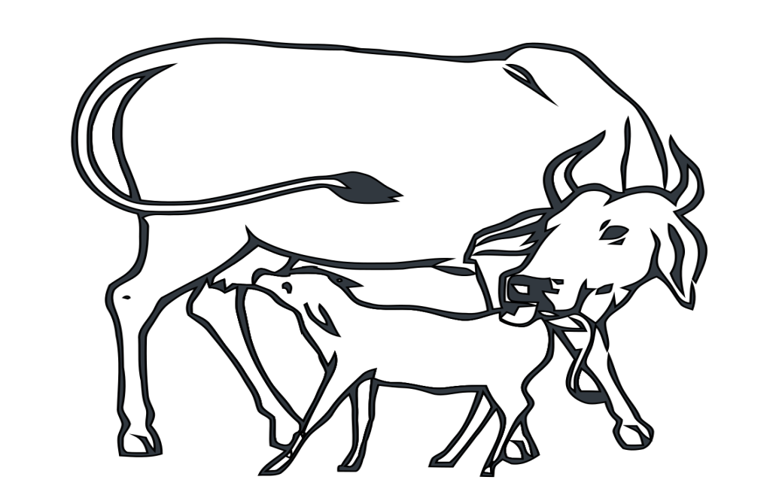
STRAY CATTLE CHALLENGE
TEAM NAME: WHIZ - KIDS
MINISTRY : Government Of Goa
CATEGORY : Software
TECHNOLOGY BUCKET : Mobile App Development
PROBLEM STATEMENT : Checking the menace of Stray Cattle in the state of Goa by involving Municipalities, Animal Husbandry, NGO and panchayats. The aim is to build mobile based dynamic reporting system which will facilitate into flow of information among all concerned stakeholders. The aim is also to provide better Governance by more involvement of public.
TEAM MEMBERS: Ameesha Jain , Aishwarya Verma , Ayushi Dixit ,Anukriti Sharma ,
Abhitansh Gupta , Bhagya Singh Purba

Slide 2


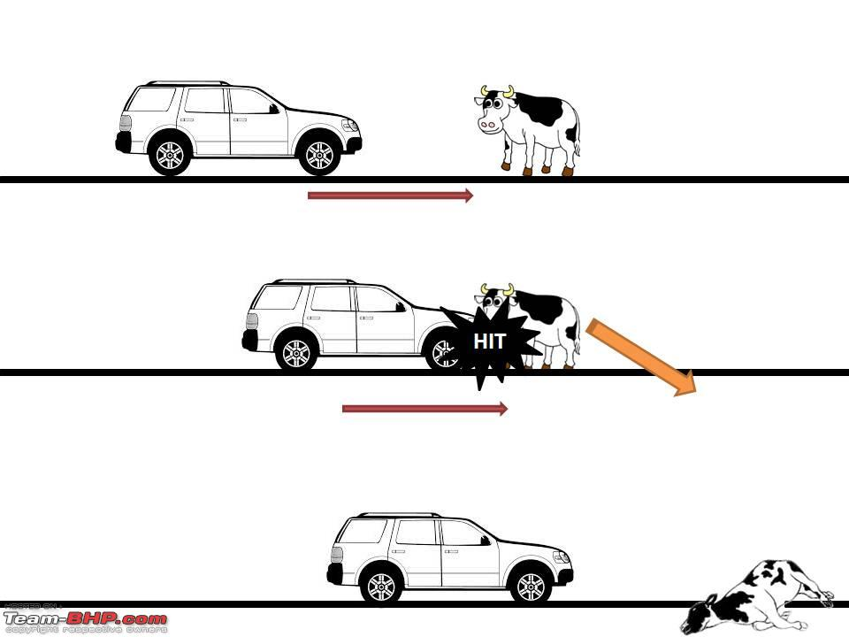








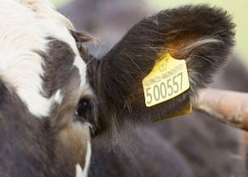
PROTOTYPE
5. STORING INFO. GIVEN
BY USER
6
11
1. STRAY CATTLE SPOTTED
5
1
DATABASE
6. INFO. RECIEVED
BY MUNICIPAL
WORKER
11.FINE IMPOSED THE
ON OWNER
3. CLICK PHOTOS OF CATTLE
BY USING OUR APP
2
3
10.CATTLE IF OWNED
PICKED UP BY OWNER
7
LOGIN
10
7.CATTLE VAN SENT
TO THE SPOT
LOGIN
LOGIN
9
8
4
2. LOGIN INTO OUR
APP
4. GIVING THE LOCATION
OF CATTLE USING GPS
8. CATTLE EAR TAGS ARE SCANNED
WITH OUR APP AND
OWNER DETAILS ARE RECIEVED
9.CATTLE IF STRAY SENT
TO ANIMAL HUSBANDRY

Slide 3
USE CASE DIAGRAM
LOGIN
REGISTER
VERIFY PASSWORD
LOGIN ERROR
OWNER
DETAILS
MUNICIPAL
WORKER
2263
MAKE A REPORT
EAR TAG
DATABASE
DESCRIPTION
CATTLE EAR
TAG ID
USER
OWNER
UPLOAD PHOTO
DATABASE
STORAGE
LOCATION INFO
SUBMIT
ANIMAL
HUSBANDRY
Notes:
PANCHAYAT

Slide 4
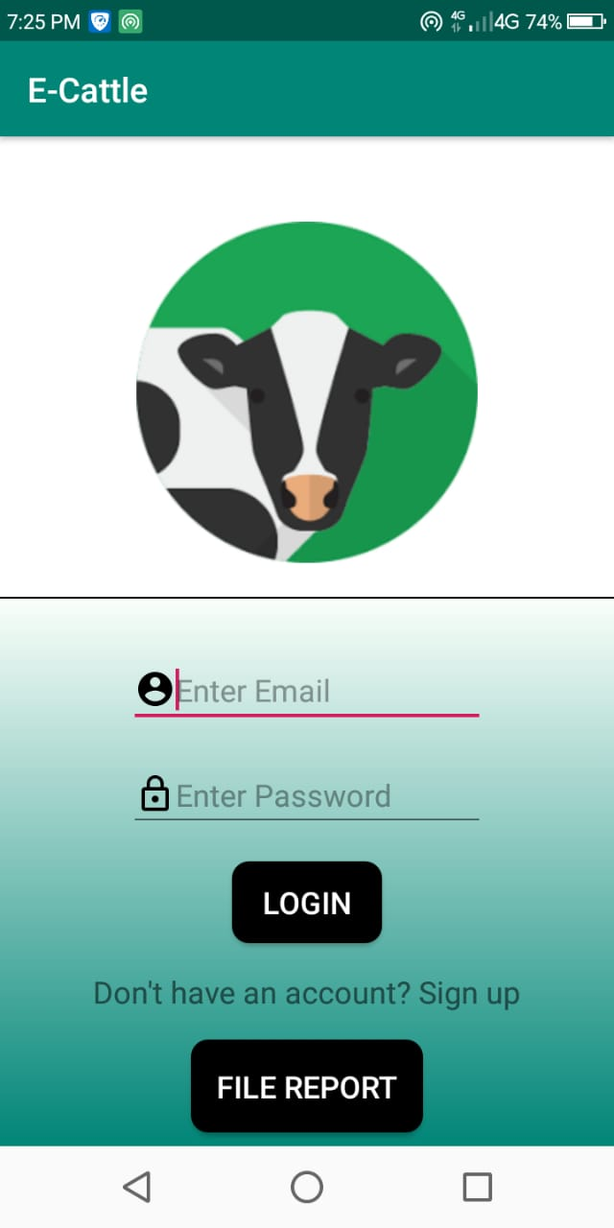
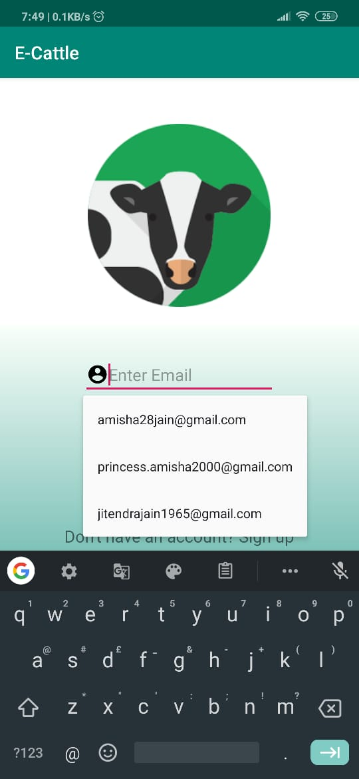
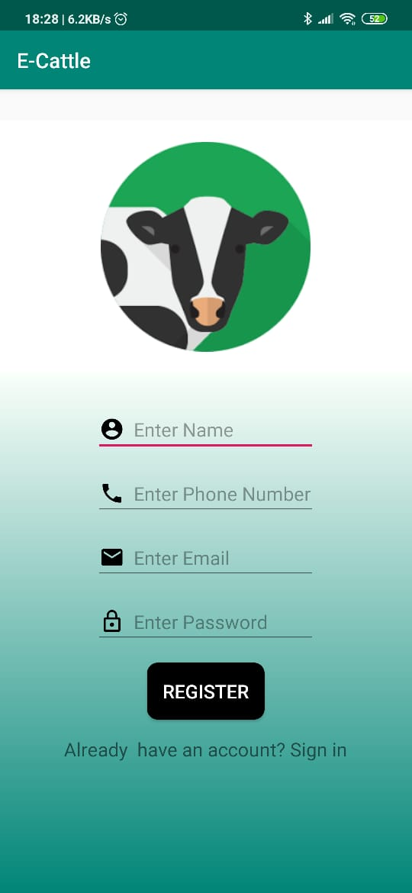
WORKING OF OUR APP
MUNICIPAL EMPLOYEE HAS TO LOGIN INTO OUR APP IF ALREADY REGISTERD AND USER WILL GO TO “FILE REPORT”
2. IF NOT THEN REGISTER
YOURSELF HERE

Slide 5
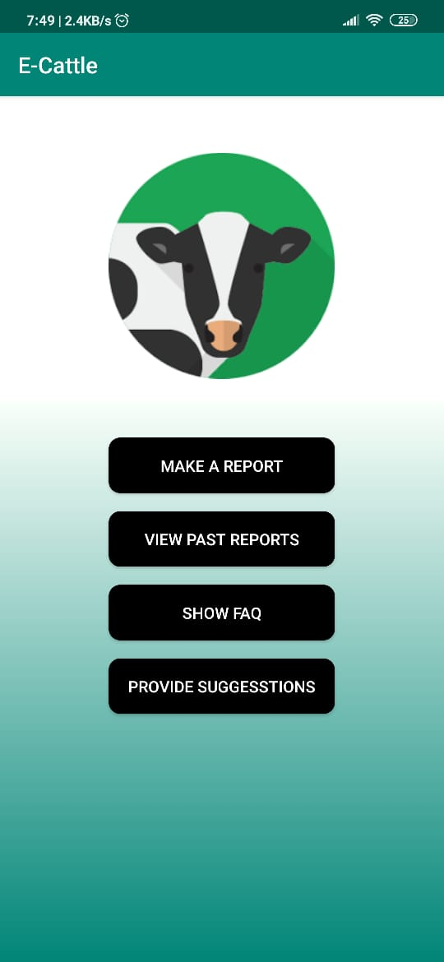
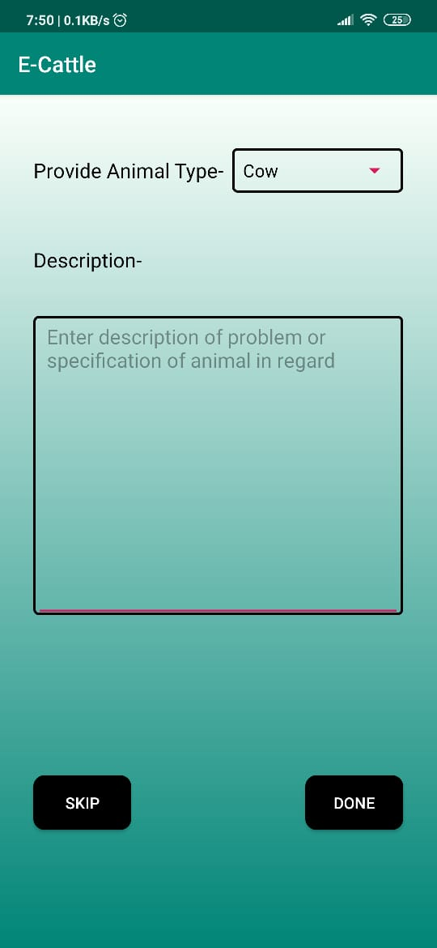
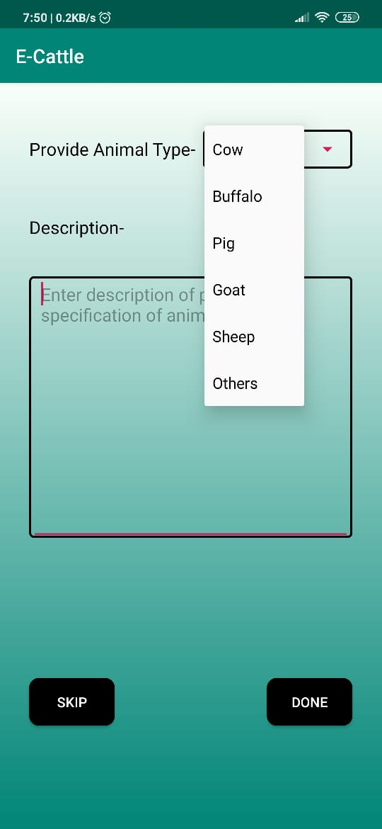
3. AFTER CLICKING ON “FILE
REPORT” USER HAS TO GO
TO “MAKE A REPORT”
4. AFTER THIS A DESCRIPTION
ACTIVITY OPENS WHICH IS
OPTIONAL TO FILL
5. HERE USER HAD TO
PROVIDE CATTLE DETAILS
AND DESCRIBE THE CATTLE

Slide 6
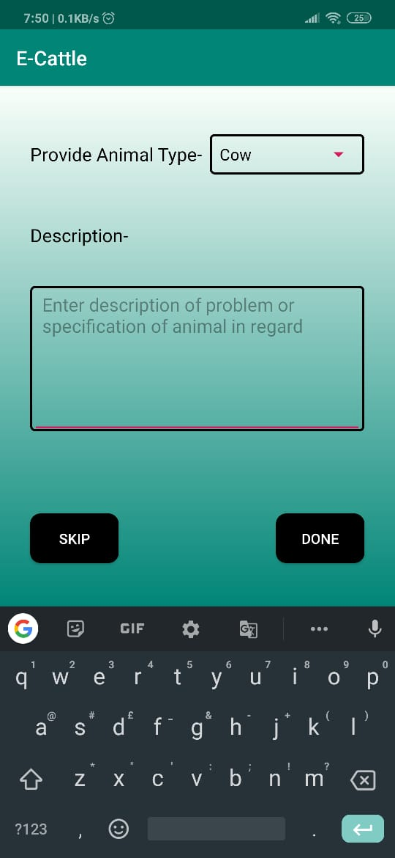
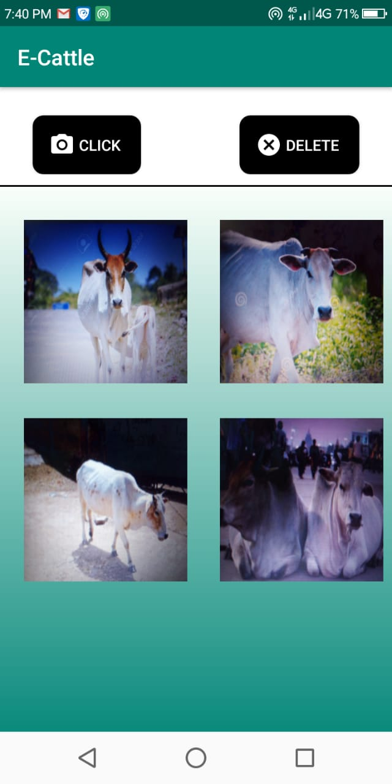
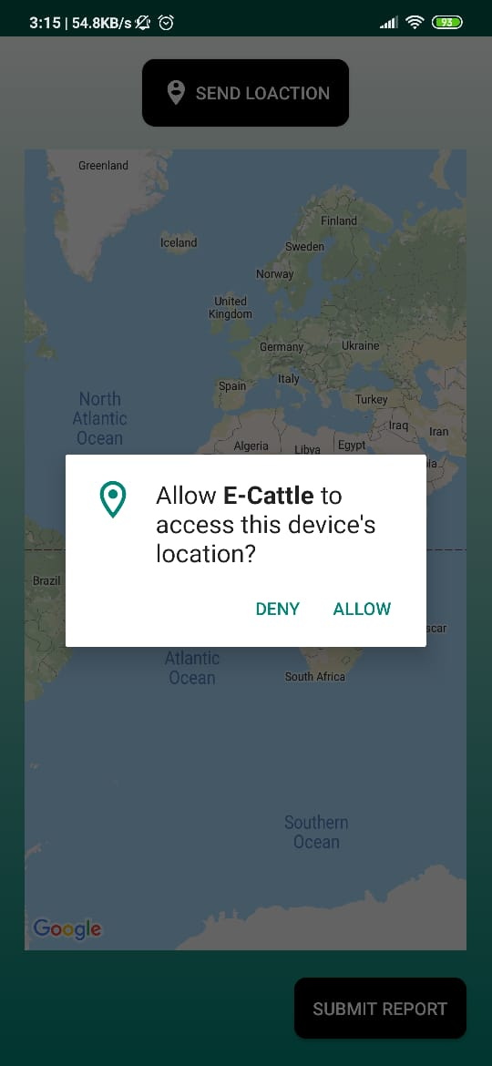
6. IF THE USER GIVE THE DETAILS
THEY WILL CLICK “DONE”,
“SKIP” IF NOT PROVIDING
7. AFTER THIS CAMERA
ACTIVITY OPENS WHERE
USER CAN TAKE IMAGES
AND CLICK “DONE”
8. AFTER CAMERA ACTIVITY
LOCATION ACTIVITY OPENS
WHICH ASKS USER TO GIVE
ACCESS PERMISSION
DONE

Slide 7
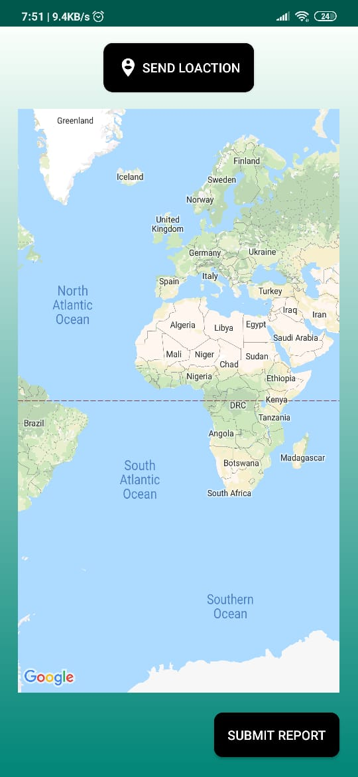
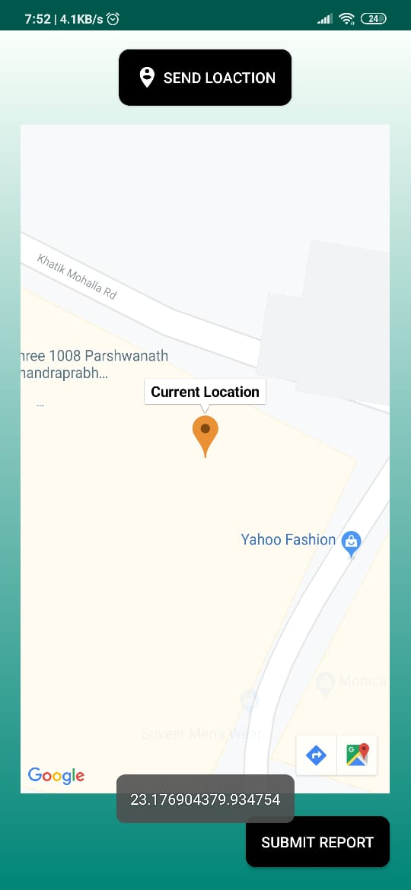
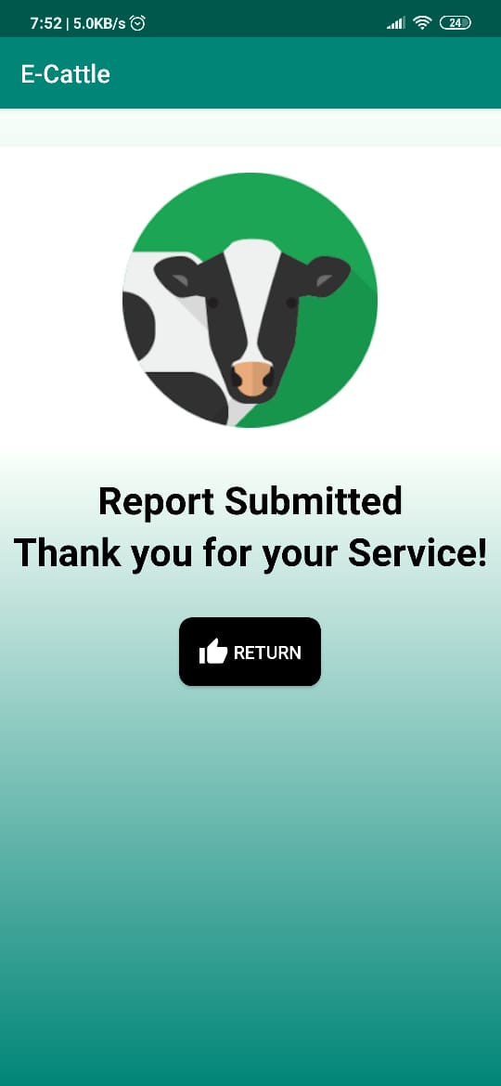
9. WHEN USER CLICK ON
“SEND LOCATION” IT SEARCH
FOR CURRENT LOCATION
10. WHEN CURRENT LOCATION
IS FOUND USER WILL CLICK
ON “SUBMIT REPORT”
11.WHEN REPORT IS SUBMITTED
A ACTIVITY IS SHOWN OF
SUCCESSFUL SUBMISSION

Slide 8
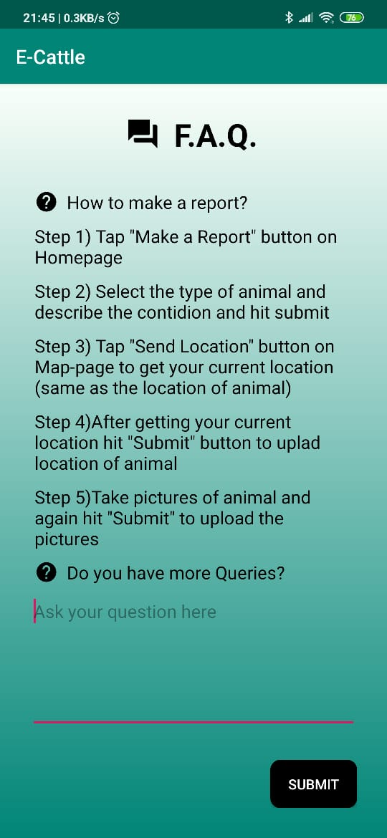
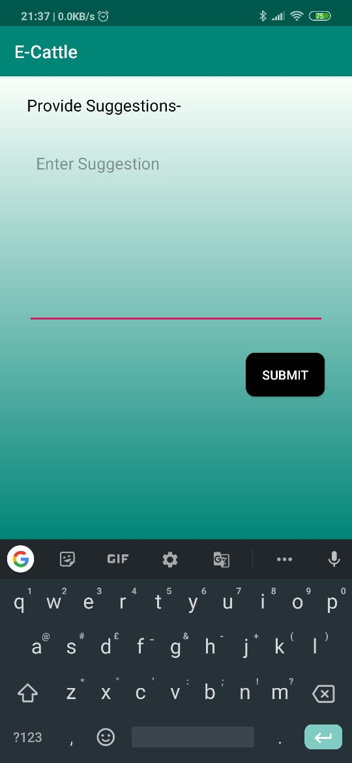
12. IF A USER CLICKS ON
“RETURN” THEY WILL
COME TO MAIN MENU
13. WHEN USER CLICK ON
“SHOW FAQ” THE ACTIVITY
SHOWN BELOW WILL OPEN
14. WHEN USER CLICK ON
“PROVIDE SUGGESSTIONS”
THIS ACTIVITY OPENS

Slide 9
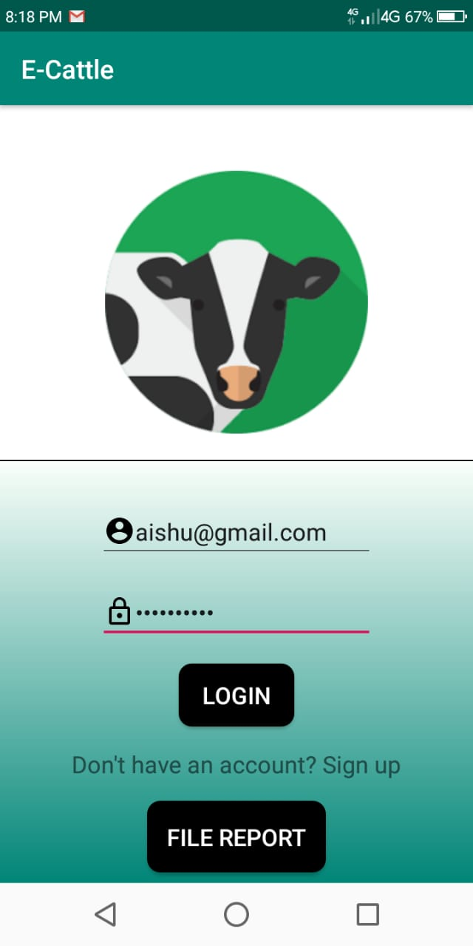
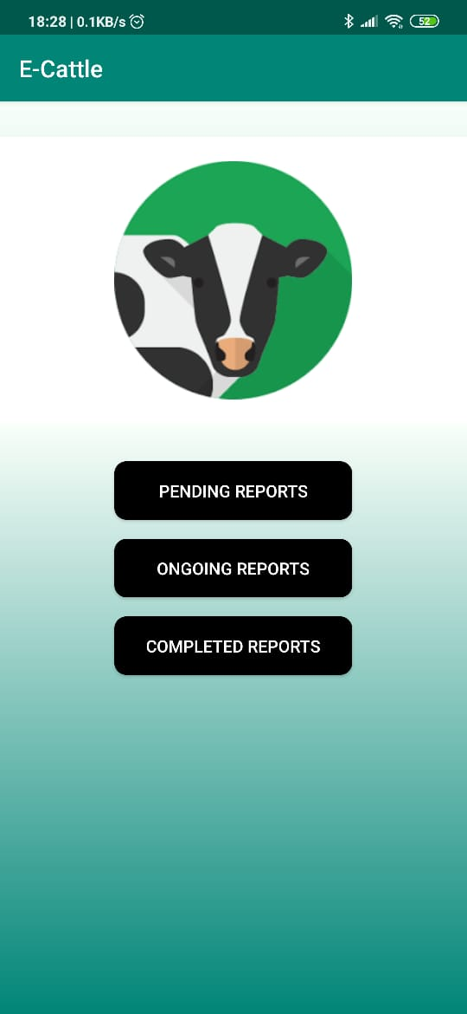
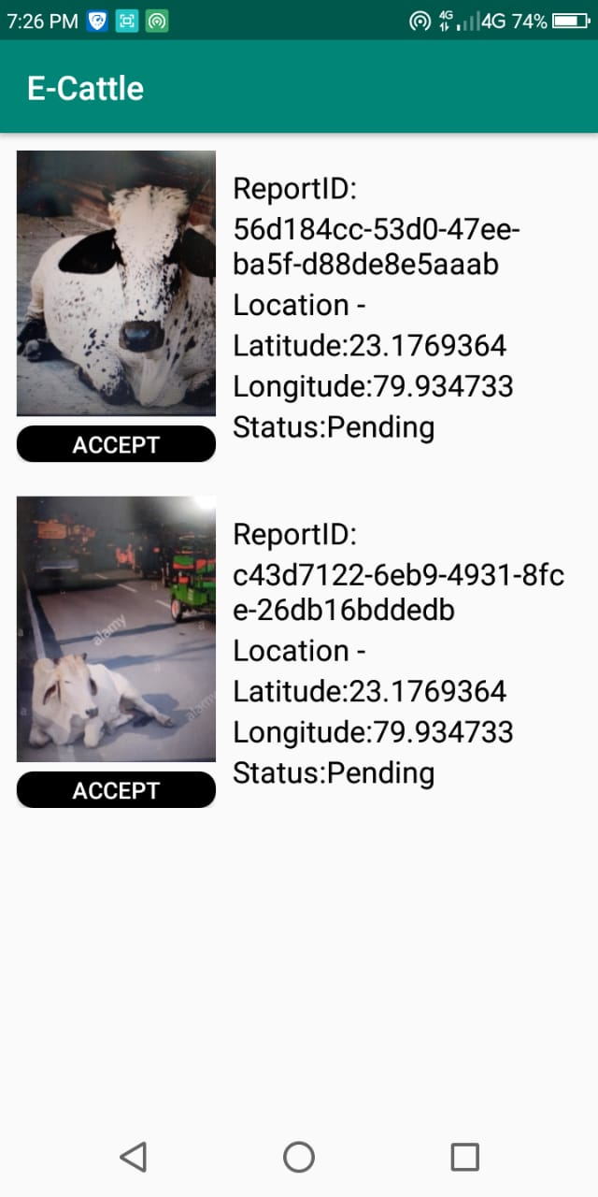
MUNICIPAL EMPLOYEE USING OUR APP
1.LOGIN PERFORMED BY THE
MUNICIPAL EMPLOYEE
2. AFTER SUCCESSFUL LOGIN
THE ACTIVITY SHOWN BELOW
OPENS
3. WHEN WORKER CLICK ON
“PENDING REPORTS” THE
ACTIVITY SHOWN OPENS

Slide 10
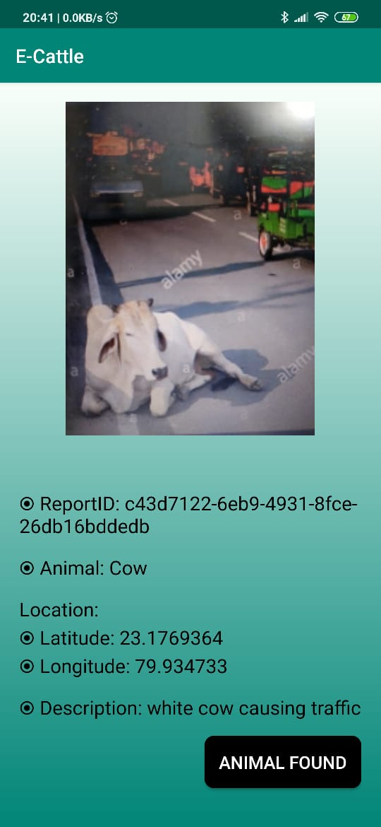
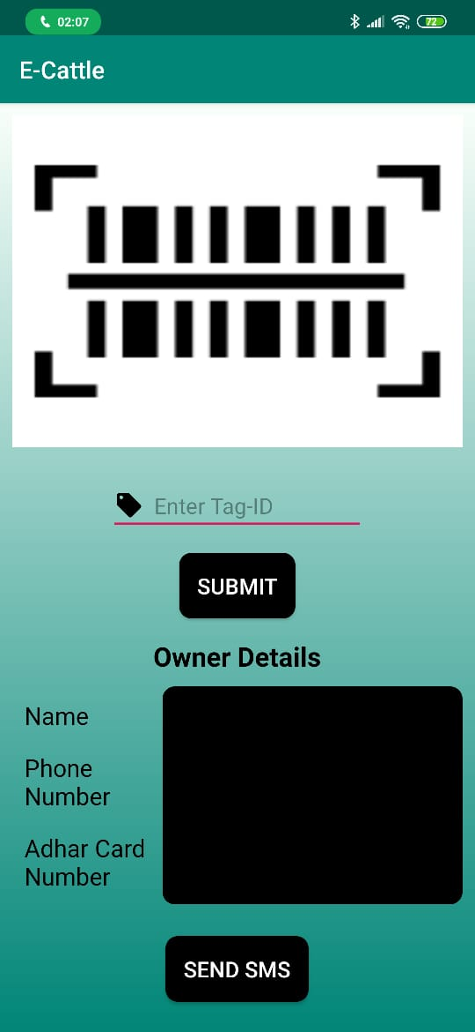
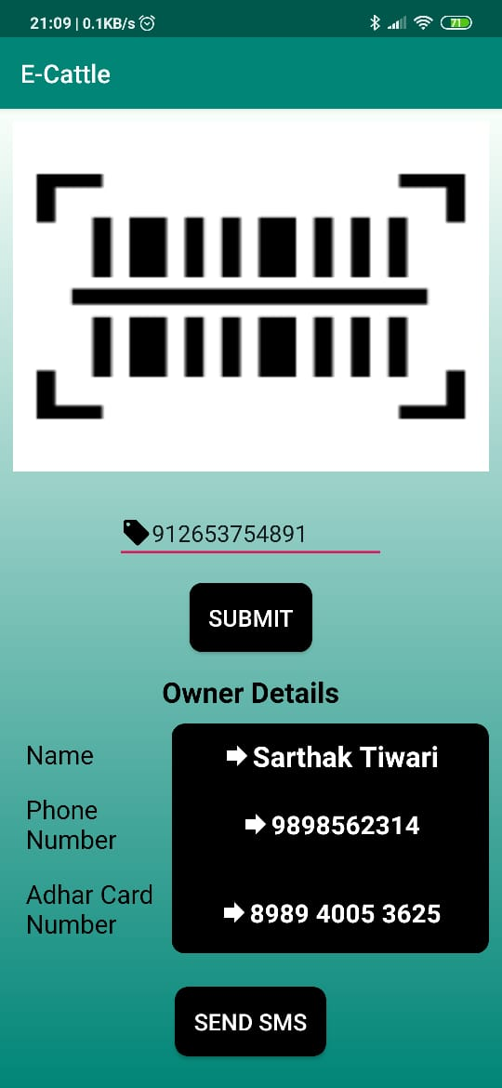
4. WHEN WORKER “ACCEPT”
THE REPORT , THE ACTIVITY
SHOWN BELOW OPENS WHICH
SHOW DETAILS OF REPORT
5. WHEN WORKER CLICKS ON “ANIMAL FOUND”ACTIVITY OPENS WHERE TAG ID IS ENTERED AND OWNER DETAILS ARE RECIEVED
6. WHEN TAG ID IS
ENTERED THE DETAILS
OF OWNER ARE RECIEVED

Slide 11
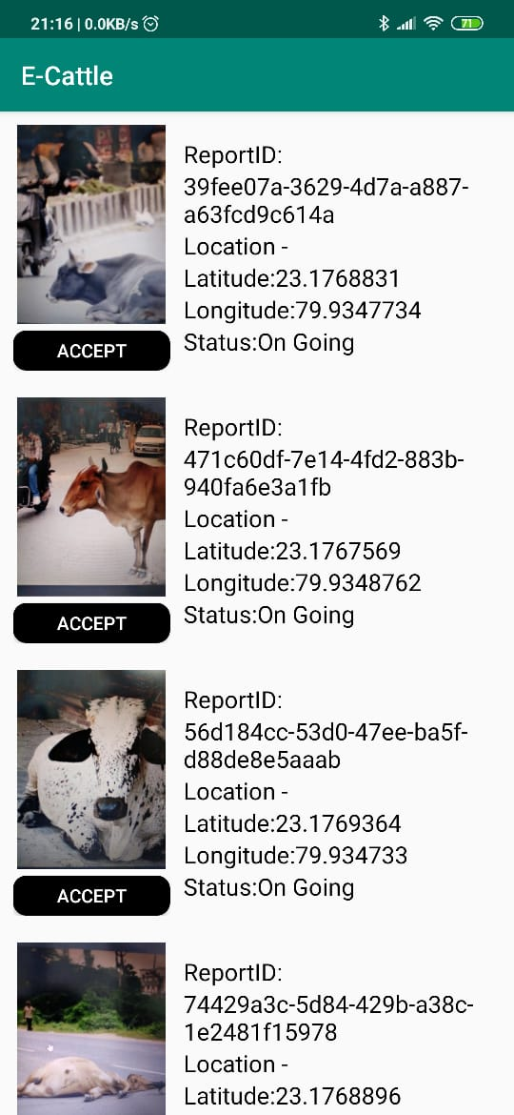
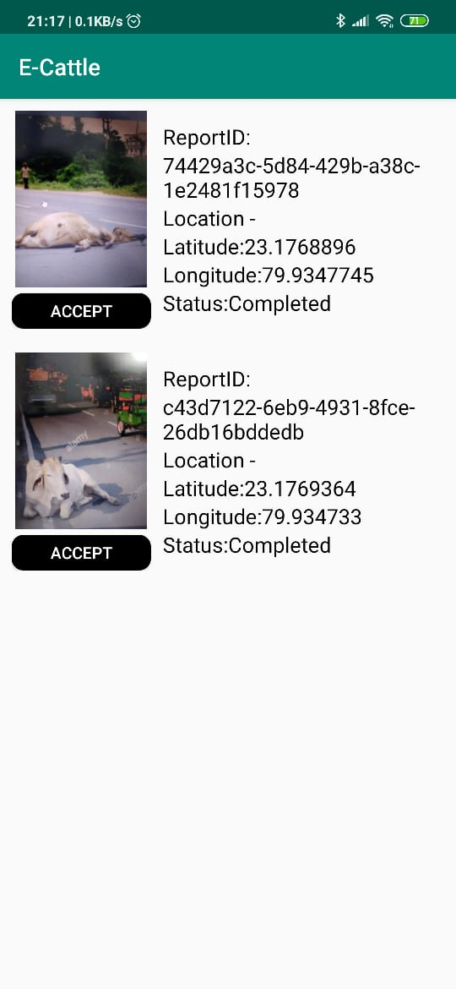
7.WHEN THE WORKER CLICKS
ON “ONGOING REPORTS” THE
ACTIVITY SHOWN BELOW OPENS
8. WHEN THE EMPLOYEE CLICKS
ON “COMPLETED REPORTS” THE
REPORTS ON WHICH ACTION
ARE COMPLETED ARE SHOWN

Slide 12
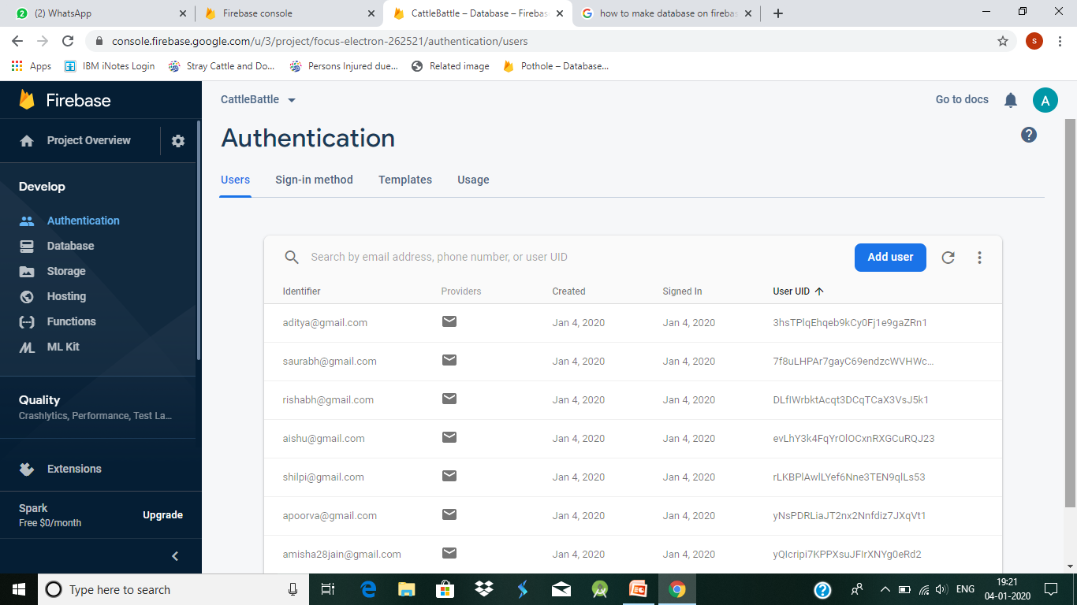
DATABASE CONNECTIVITY OF OUR APP
WHEN A WORKER LOGIN INTO OUR APP THEN THERE LOGIN INFO. IS STORED OUR DATABASE AND EACH WORKER IS ASSIGNED A UNIQUE USER UID.

Slide 13
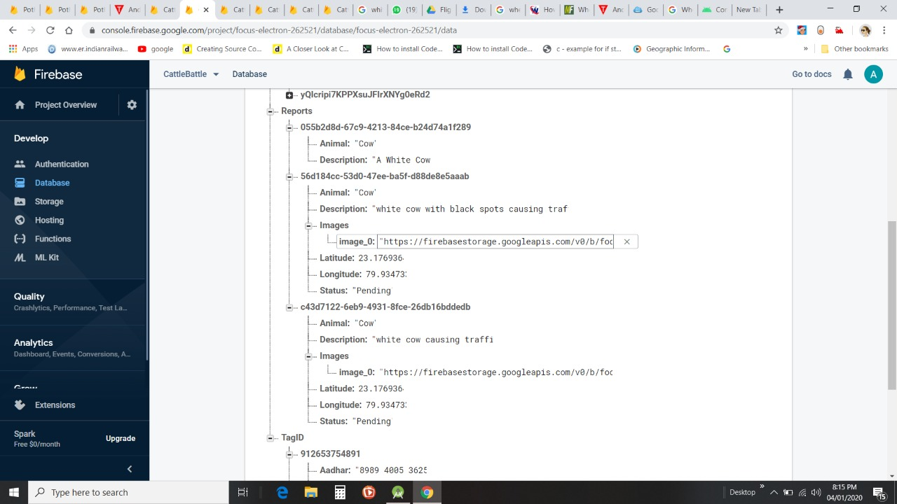
2. WHEN A USER SUBMIT THE LOCATION AND IMAGE OF THE CATTLE AND DETAILS ARE
STORED IN THE DATABASE AND UNIQUE REPORT ID IS GENERATED

Slide 14
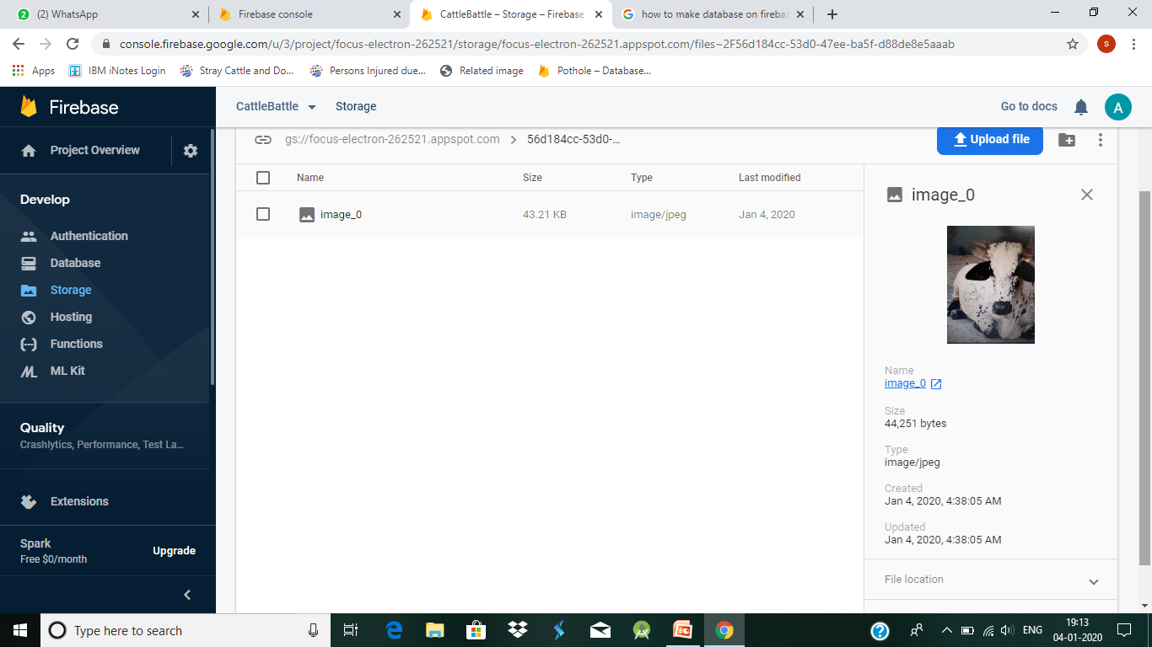
3. THE IMAGES SUBMITTED BY USER IS STORED IN STORAGE SECTION OF DATABASE AND
CAN BE ACCESSED WITH THE HELP OF USER UID AND REPORT ID

Slide 15
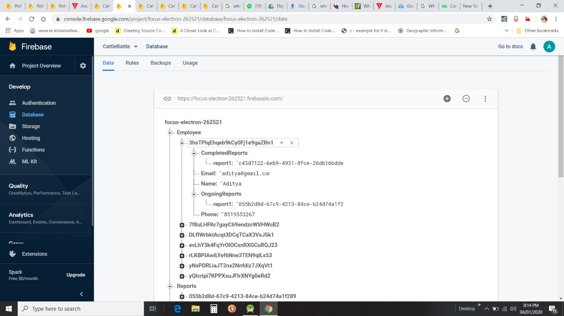
4. THE BELOW DATABASE IMAGE SHOWS THE STATUS OF REPORT THAT IS THE ACTION TAKEN
BY THE MUNICIPAL ON THE REPORT SUBMITTED BY THE USER

Slide 16
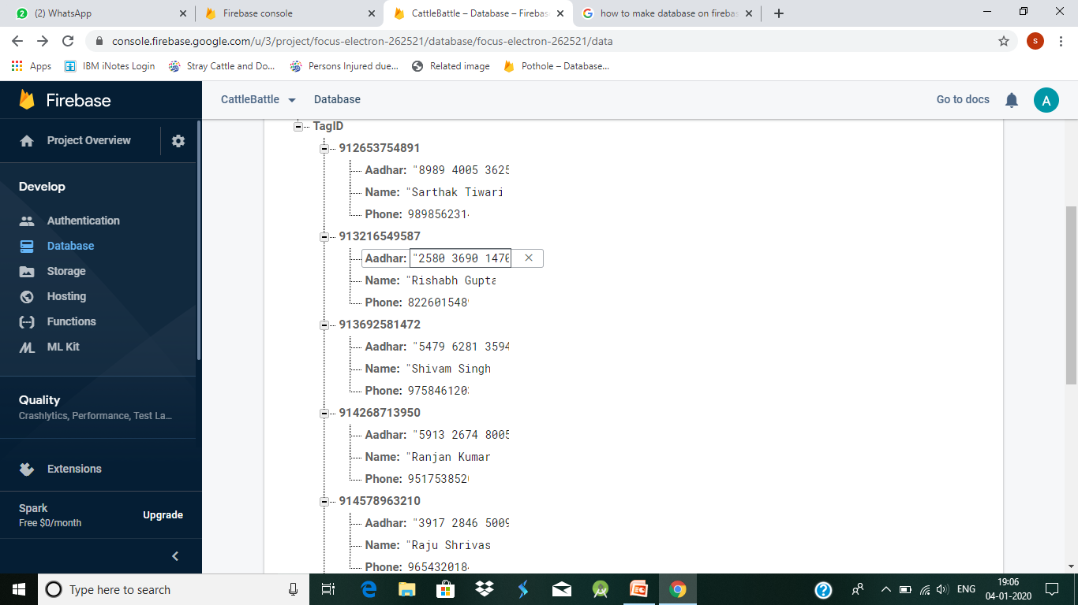
CATTLE EAR TAG DATABASE

Slide 17
TECHNOLOGY STACK
FRONT END:
ANDROID STUDIO
BACK END:
FIREBASE DATBASE
LANGUAGE:
JAVA

Slide 18

FINE IMPOSED BY GOVERNMENT OF GOA
The Goa State Government has made certain rules regarding the fine system of the state. When the cattle is captured by the municipal and the owner claims it then following penalty rules are imposed.
The rules are as follows :-
If the stray cattle is claimed within a period of 7 days -> Fine of Rs.3000/- plus delivery charges is imposed.
If stray cattle is claimed beyond a period of 7 days but within 15 days -> Fine of Rs.5000/- is imposed.
Subsequent or frequent impounding will attract increased charges @ 20% extra on each escape.

Slide 19
2012 LIVESTOCK CENSUS
STATISTICS
DISTRICT | TOTAL EXOTIC CATTLE | TOTAL INDIGENOUS CATTLE | TOTAL CATTLE
NORTH GOA | 9564 | 20458 | 30022
SOUTH GOA | 7962 | 19496 | 27458
STATE TOTAL | 17526 | 39954 | 57480
The data in the table is obtained from the site Data.gov.in .These statistics are issued by Ministry Of Agriculture And Animal Welfare , Department Of Animal Husbandry, Dairying And Fisheries.
2012 STRAY CATTLE CENSUS
DISTRICT | STRAY CATTLE
NORTH GOA | 4301
SOUTH GOA | 2882
STATE TOTAL | 7183
12.5% cattle is stray.
87.5% cattle are registered and not stray.
If fines are imposed only on the stray cattle which are owned once, the REVENUE GENERATED will be approx. 2 CRORE.

Slide 20
DEPENDECIES
OUR SOLUTION WILL DEPEND ON THE DATABASE OF EAR TAG MAINTAINED BY GOVERNMENT WHEN
IMPLEMENTED.
2. ALL THE OWNED CATTLES ARE REQUIRED TO BE TAGGED
SO THAT THERE DETAILS ARE PRESENT IN DATABASE AND
MUNICIPAL CAN ACCESS IT IN ORDER TO INFORM THE
OWNER ABOUT THERE CATTLE WHICH IS CAUGHT AS STRAY.
3. OUR SOLUTION DEPEND ON THE READINESS AND EFFICIENCY OF THE MUNICIPAL WORKERS.

Slide 21
CONCLUSION
OUR APP CAN BE USED TO PERFORM FUNCTIONS LISTED
BELOW:
1. REPORTING : OUR APP IS CAPABLE FOR DYNAMICALLY
REPORTING STARY CATTLES TO MUNICIPAL.
2. DATA GATHERING : OUR APP WILL HELP GOVERNMENT
IN GATHERING CENSUS OF STRAY CATTLE IN THE STATE.
3. FINDING THE OWNER : OUR APP WILL HELP MUNICIPAL
TO FIND THE OWNER OF OWNED CATTLE WHICH IS
FOUND STRAY , INFORM THEM AND IMPOSE FINE .
4. DATA ANALYTICS : THROUGH THE DATA COLLECTED BY
OUR APP WE CAN ANALYZE THE NUMBER OF ACCIDENTS
CAUSED BY CATTLE

